Slide 1



Search for production of a Higgs boson and a single top quark in multilepton final states in proton collisions at √s =13 TeV
Approval of HIG-17-005
2nd May, 2017
Pallabi Das*, Sandhya Jain, Kajari Mazumdar
(Tata Institute of Fundamental Research, Mumbai)
Jose Monroy, Benjamin Stieger, Ken Bloom
(University of Nebraska-Lincoln)

Slide 2
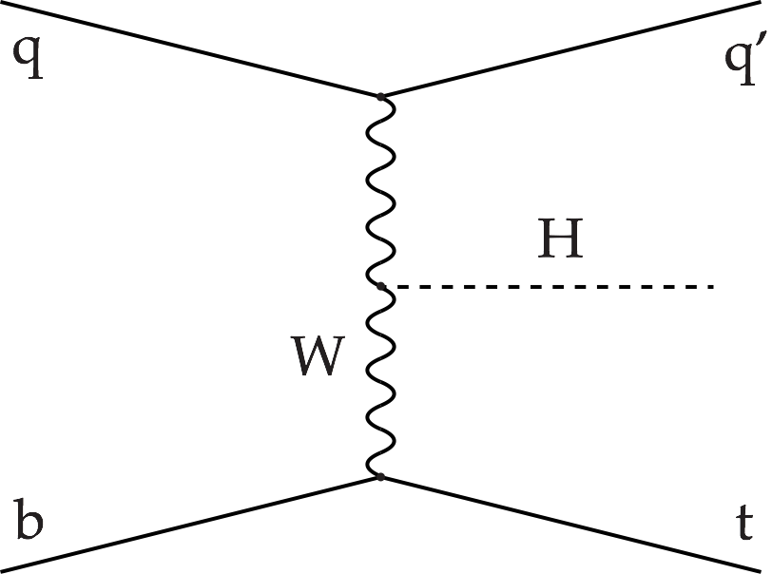
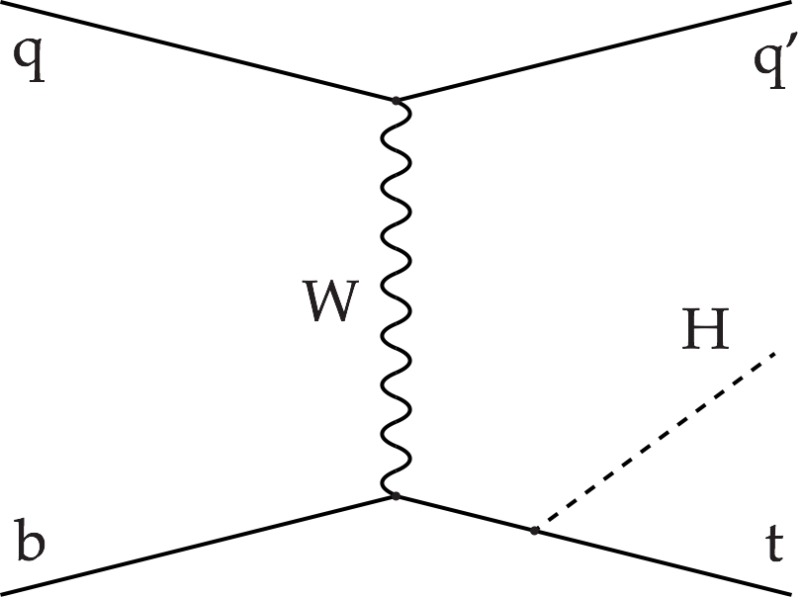
Motivation for tHq search
Measurement of couplings is essential to establish the nature of the Higgs.
Most processes are only sensitive to overall coupling strengths.
Study of tHq process exposes the relative sign of top-Higgs and W-Higgs couplings via interference.
Study the coupling modifiers 𝜅t and 𝜅V
Destructive interference in SM: 𝜎SM(𝜅V = 𝜅t =1) = 70.96 fb (√s = 13 TeV).
Large enhancement for negative relative sign between 𝜅t and 𝜅V in tHq production: e.g., 𝜎 (𝜅V = -𝜅t =1) = 792.7 fb.
Current CMS and ATLAS measurements agree well with SM values.
Similar interference effect for tHW process is observed: 𝜎SM(tHW) = 15.61 fb.

Slide 3
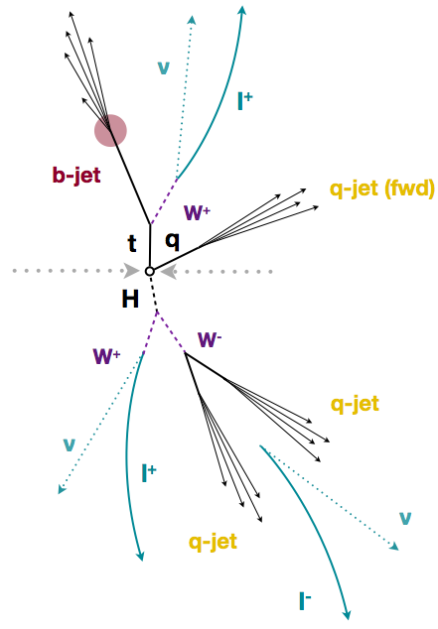
tHq multilepton signature
The characteristic feature of the tHq signal:
one light forward jet
one b jet and W boson from top decay, with W→l𝜈
one Higgs boson
Investigate two channels:
Same-sign dilepton (2lss): one W from Higgs decays hadronically, others decay leptonically.
Trilepton (3l): All three Ws decay leptonically.
Selected sample has contributions from H→WW* (~75%), 𝜏𝜏(~20%), ZZ*(~5%) decays.

Slide 4
Analysis workflow
Data/MC
Trigger
Object
selection
Event
selection
2 BDT
trainings (MC) for
2 major bkg.
2D BDT
plots
Consider
different
(𝜅t,𝜅V) values
Shape analysis
including systematics
Binned 1D
plot
Limits on
signal strength
r(tHq+tHW+ttH)
Impacts + post-fit plots

Slide 5
Updates since pre-approval
Tightened lepton MVA Id: selection cut changed to 0.9 from 0.75, resulting in reduced fake acceptance and ~10% improved limit.
Increased pT threshold of trailing leptons to 15 GeV: to obtain better fake rate closure and trigger efficiency.
Increased pT threshold to 40 GeV for forward ( |𝜂| > 2.4 ) light quark jet: better data/MC agreement observed at higher 𝜂 region.
Updated physics model (scaling BRs with 𝜅t, 𝜅V in addition to cross sections).
Include ttH to multilepton as signal component (𝜎SM ~500 fb).
→ sensitivity improved.
Results:
Limit on 𝜎(tHq+tHW+ttH)xBR(H→WW*, 𝜏𝜏, ZZ*) as a function of 𝜅t/𝜅V.
Added scans of significances, best-fit cross sections and expected limits in presence of SM-like signal.
Checked the overlap between the tHq and ttH selection, in light of possible combination of the two channels in near future.

Slide 6
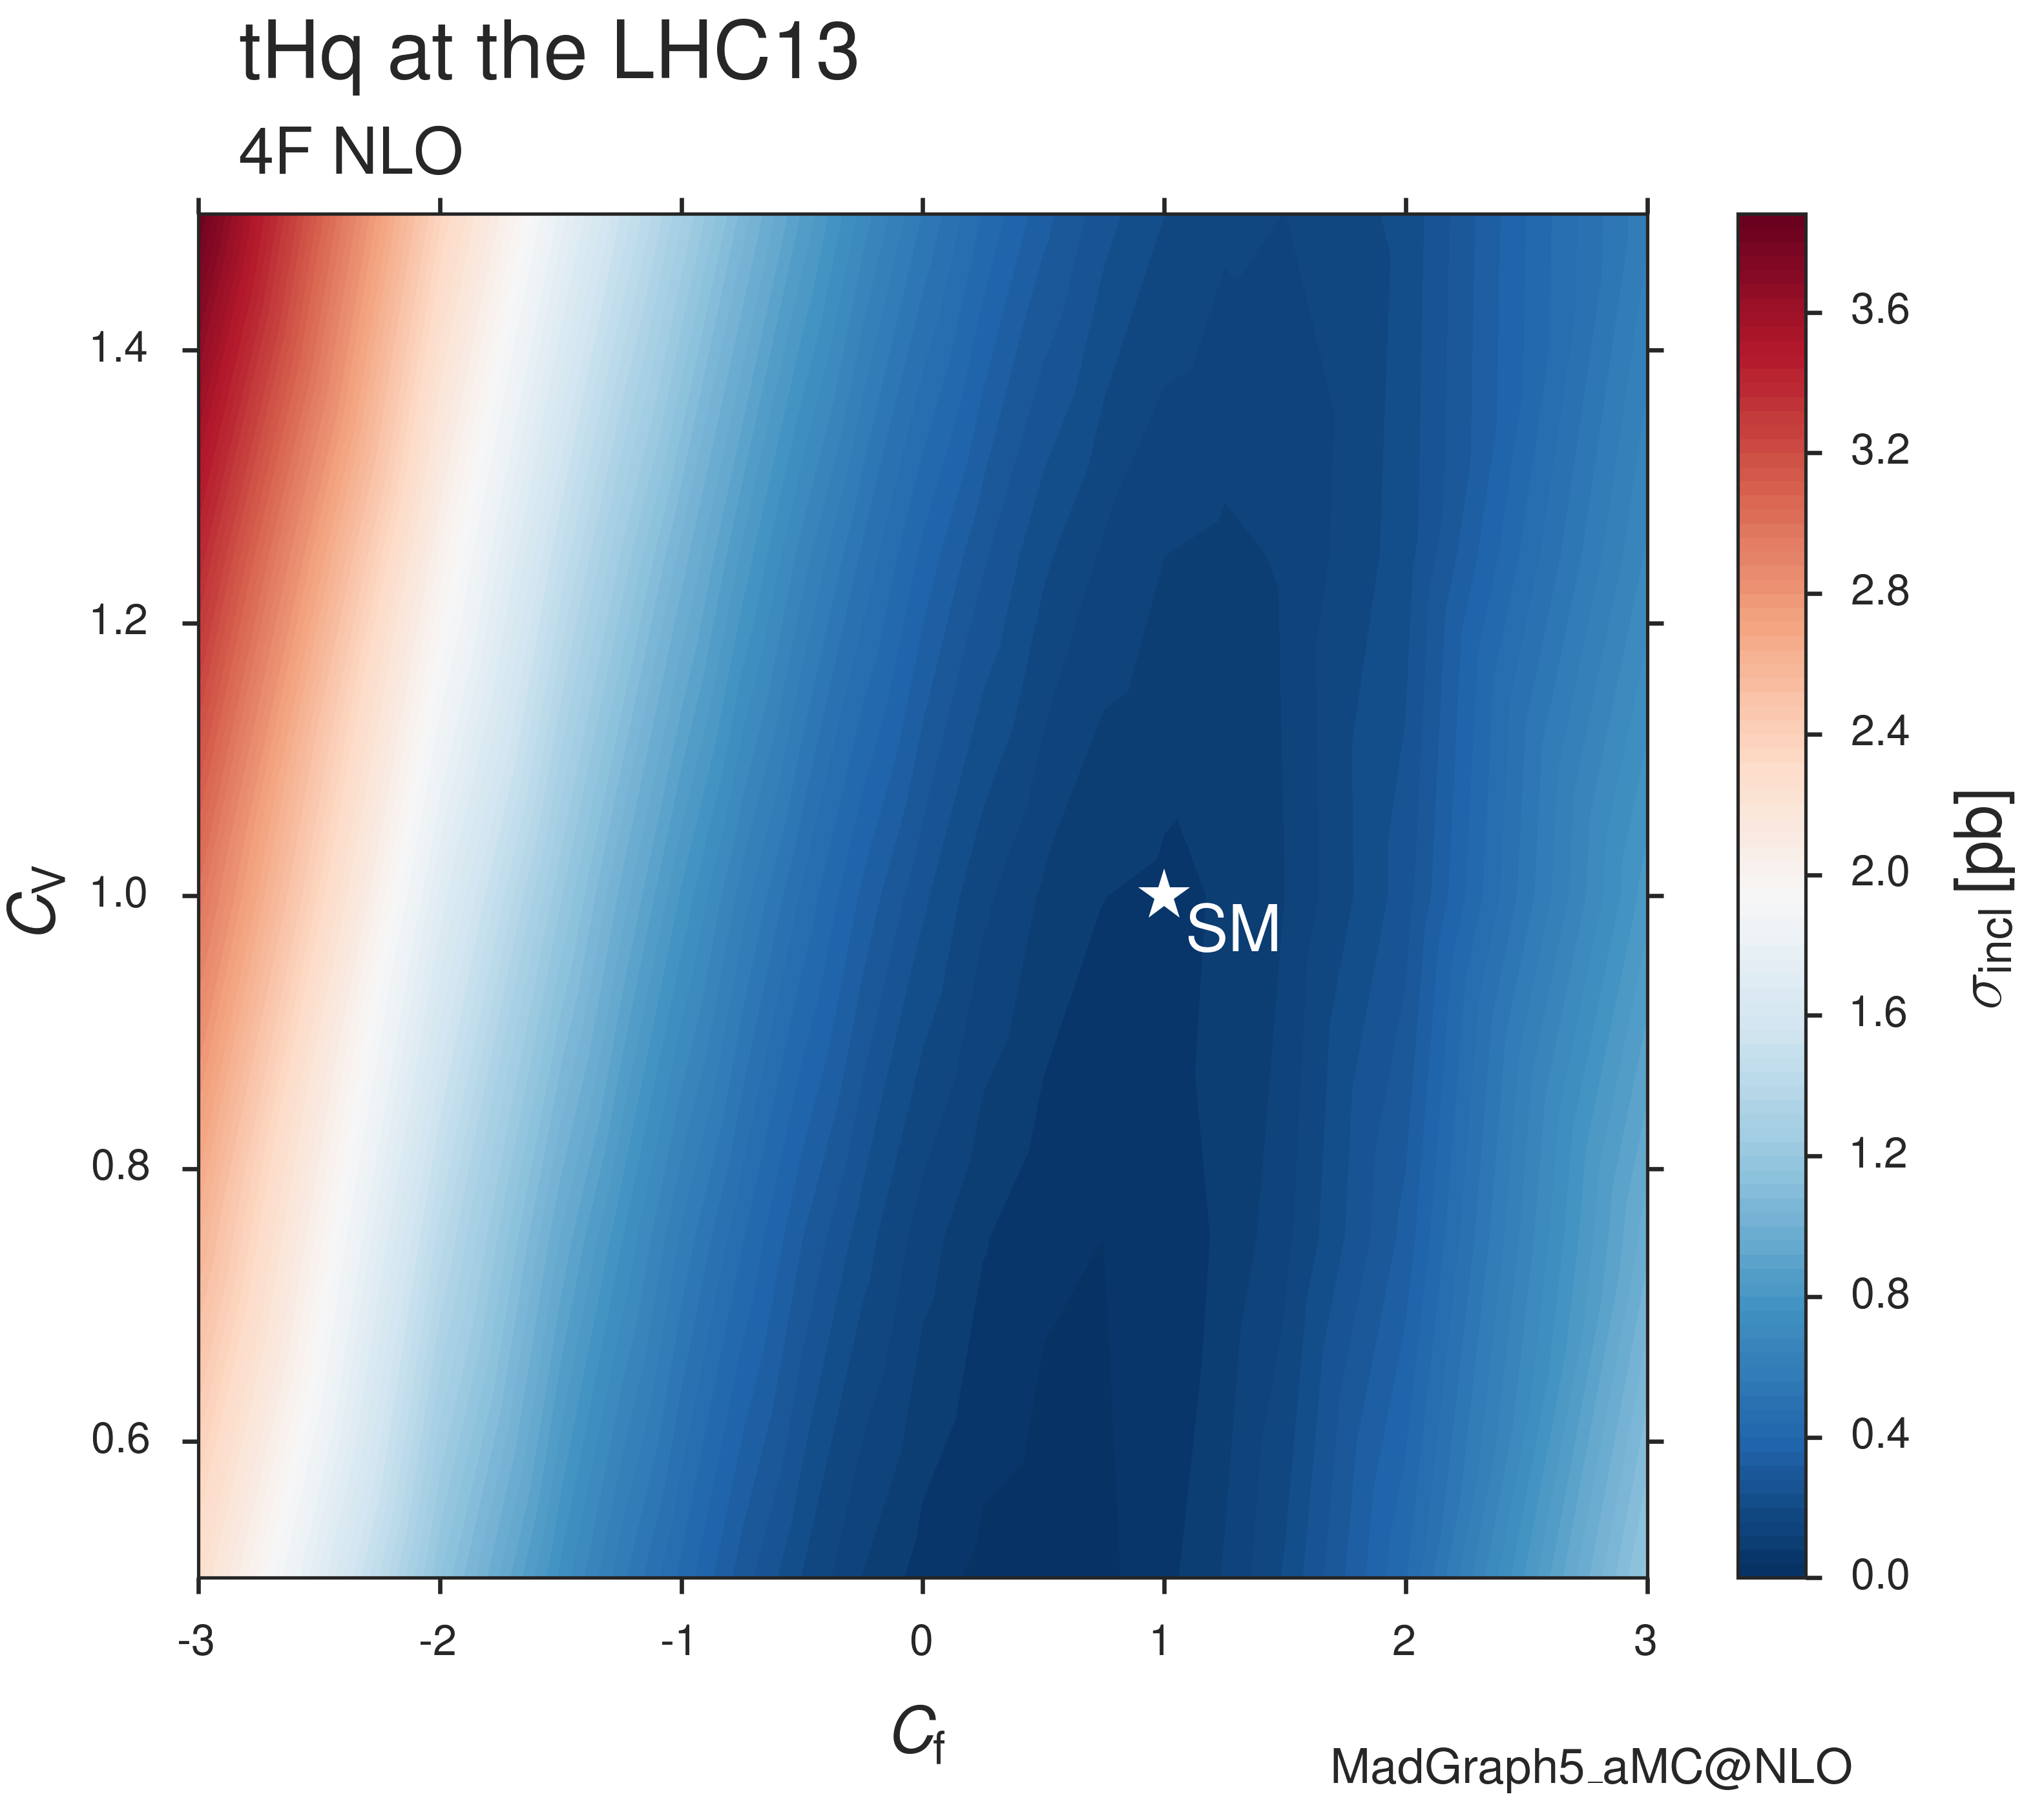
Signal modelling
MC samples for tHq and tHW modelled with MG5_aMC@NLO at leading order.
Four flavor scheme for tHq
Five flavor scheme for tHW (to avoid overlap with ttH process)
Forced leptonic decay for top in tHq sample, inclusive decays in tHW sample.
51 combinations of (𝜅t, 𝜅V) using LHE weights:
𝜅V = 0.5, 1.0, 1.5
17 points ranging from -3 to 3 for 𝜅t,.
33 unique values of the ratio 𝜅t/𝜅V in the range (-6, 6).
𝜅t/𝜅V=-1
𝜅t/𝜅V=1
𝜅V
𝜅t/𝜅V=-2
𝜅t/𝜅V=2
𝜅t
Representative lines corresponding
to constant 𝜅t/𝜅V ratio

Slide 7
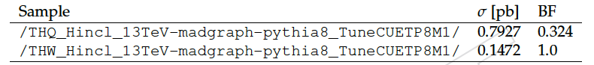
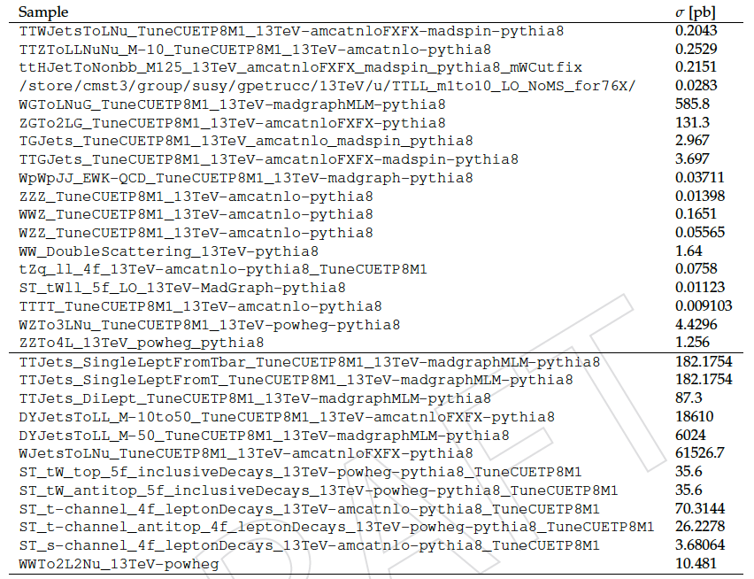
Data and Monte Carlo samples
Data: Full 2016 dataset with integrated luminosity 35.9 fb⁻¹.
23 Sep 2016 re-reco(Run B to G), Prompt-reco(Run H).
MC: PU Moriond 17 samples, corrected for efficiency scale factors and pile-up weights. Scaled to NLO or NNLO cross section as applicable.
signal
Prompt
leptons
backgrounds
Non-prompt
leptons

Slide 8
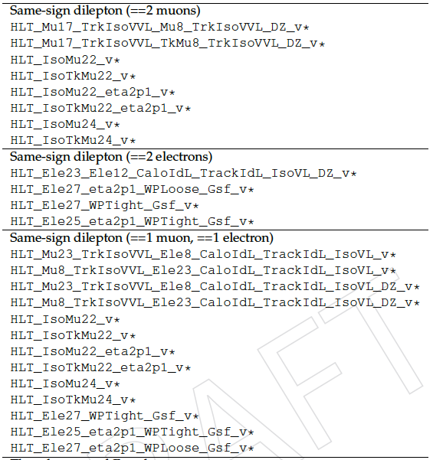
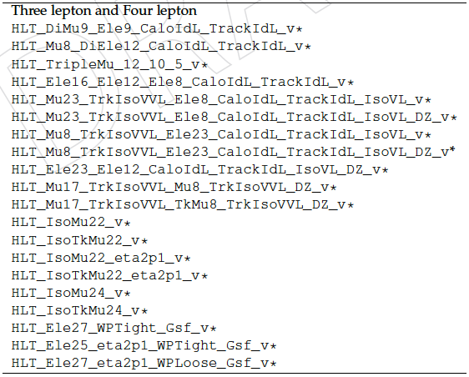
Triggers and efficiencies
Same set of single, di- and multi-lepton triggers as ttH analysis(HIG-17-004).
Efficiency: measured in events collected with MET trigger ~1% difference between data and MC (See backup for details).
accounted for via scale factors.

Slide 9
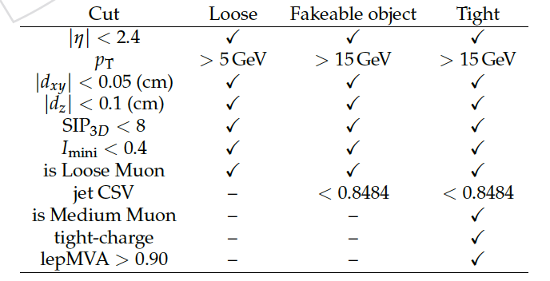
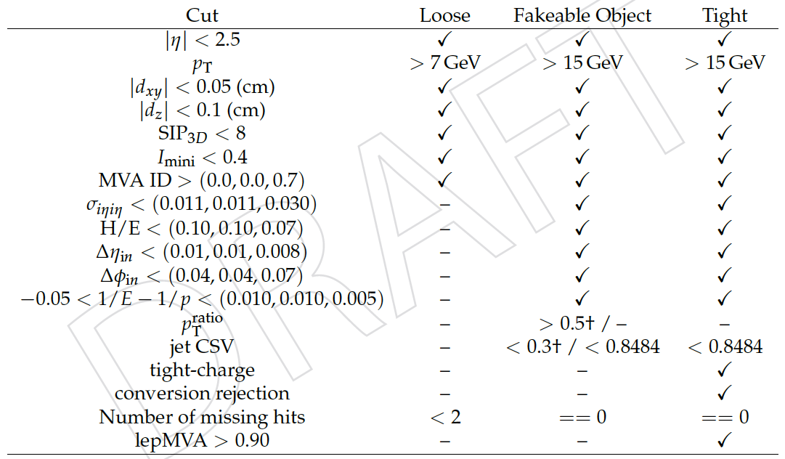
Object selection
Use lepton MVA developed for ttH analysis for optimal selection of prompt leptons and suppression of non-prompt leptons.
Three levels of lepton selection: loose (low resonance event veto), fakeable object (fake estimation from data), tight (actual signal selection).
Muons
Electrons
Jets
AK4 CHS PF jets, loose Id
pT > 25 GeV for |𝜂| < 2.4 and pT > 40 GeV for |𝜂| > 2.4
Separated from any fakeable lepton candidate by 𝛥R > 0.4
JEC: Summer16_23Sep2016V3
CSVv2 b-tagging loose and medium working points for identifying b-jets

Slide 10
Event selection
Common selection criteria for all channels:
Lepton preselection: no loose lepton pair with mll < 12 GeV.
b-jets: one or more jets passing CSVv2 medium w.p. (|𝜂| < 2.4).
Light quark jet: one or more jets failing the CSVv2 loose w.p. central: pT >25 GeV, |𝜂| < 2.4
forward: pT > 40 GeV, |𝜂| > 2.4
Selection criteria based on leptons:
2lss
Exactly two tight leptons with same sign.
Lepton pT > 25/15 GeV.
Electrons are triple-charge consistent.
Muon pT resolution: 𝛥pT/pT < 0.2.
3l
Exactly three tight leptons.
Lepton pT > 25/15/15 GeV.
Z veto: no OSSF pair with |mll -mZ| < 15 GeV.

Slide 11
Background estimation
Irreducible physics backgrounds: estimated from MC, data/MC scale factors for: b-tagging, lepton efficiency, triggers, PU
ttbar+X (X=W/Z/H/γ*)
Photon conversions
Rare SM (tZq, tWZ, tri-bosons, WWqq, tttt)
Di-bosons WZ, ZZ
Reducible backgrounds: estimated using a data driven method
Fakes: due to non-prompt leptons and mis-identification of jets, which pass the lepton Id cuts.
Charge Flips: due to mis-assignment of electron charge in opposite sign processes (ttbar, DY), relevant only for the 2lss channel.
Estimated using mis-id probability measured in control region defined with opposite sign electron pair in Z-resonance region.
All background contributions are obtained from ttH multilepton analysis.

Slide 12
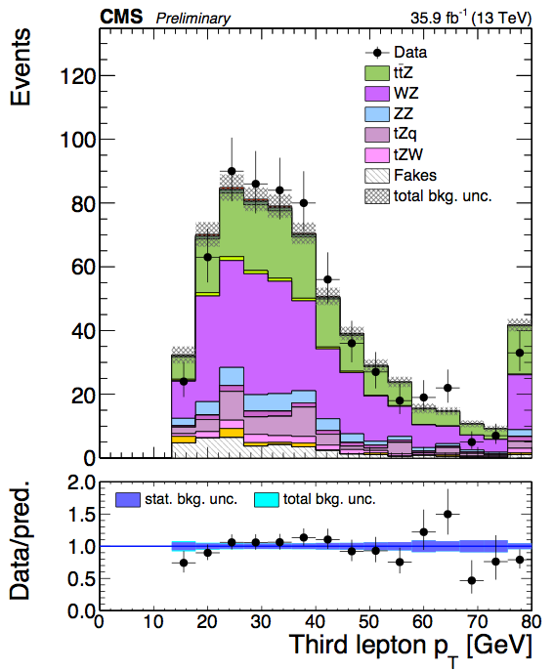
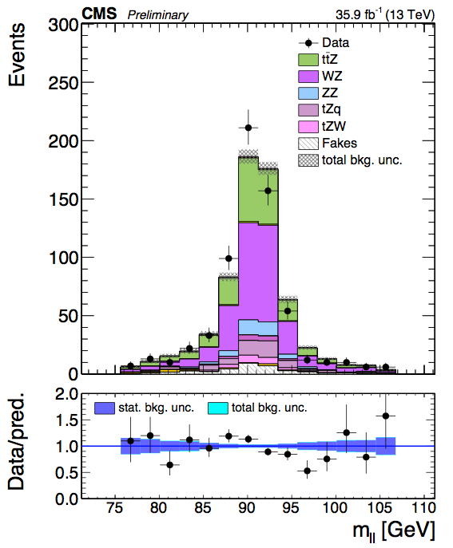
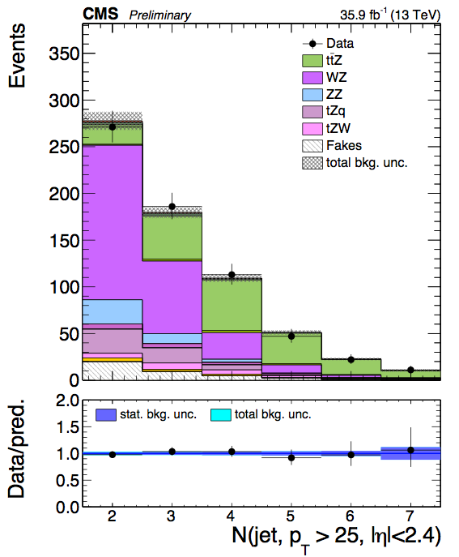
Control region for background estimation: 3l
Selection for Z-enriched CR:
Exactly three tight leptons with pT > 25/15/15 GeV.
b-jets: one or more jets passing CSVv2 loose w.p. (|𝜂| < 2.4).
Number of jets within |𝜂| < 2.4 is less than four.
Inverted Z veto: |mll -mZ| < 15 GeV (orthogonal to signal region).

Slide 13
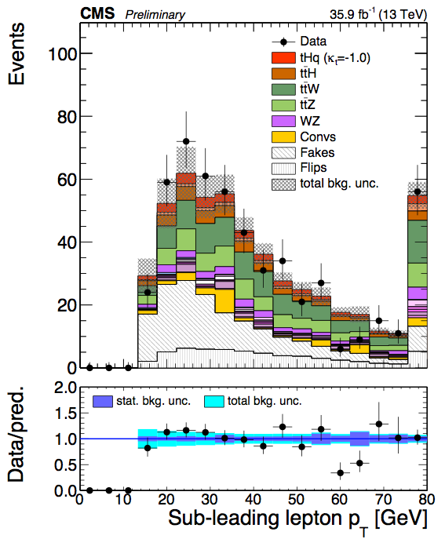
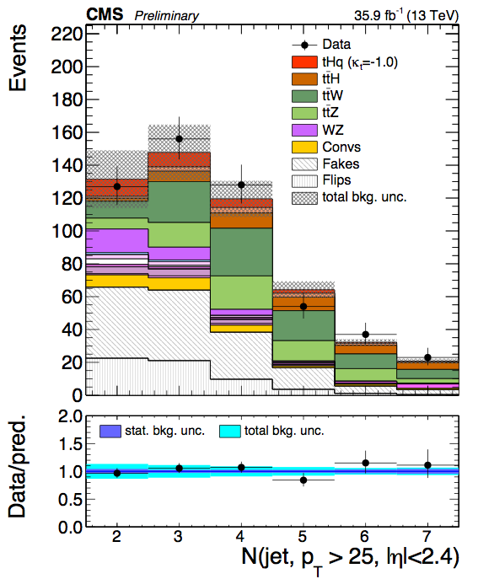
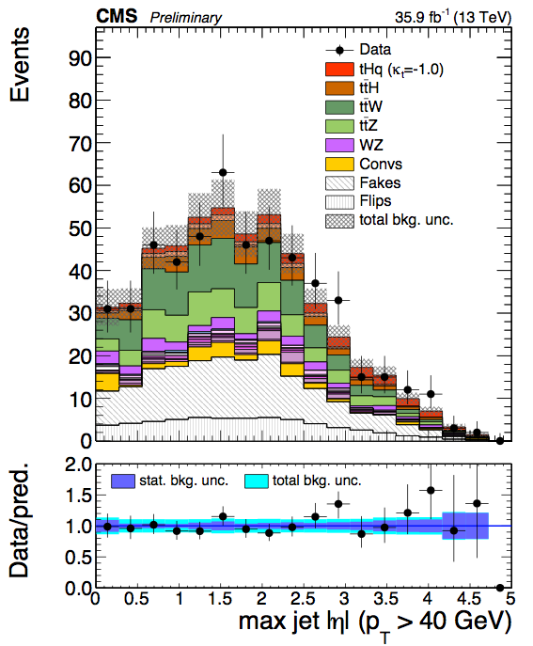
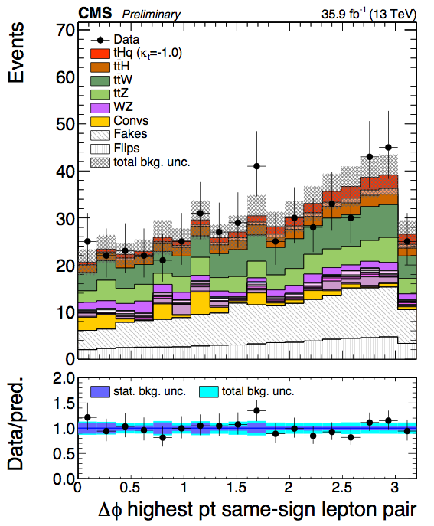
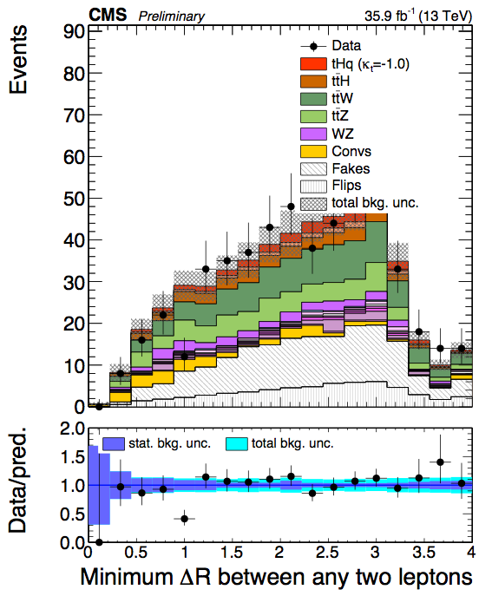
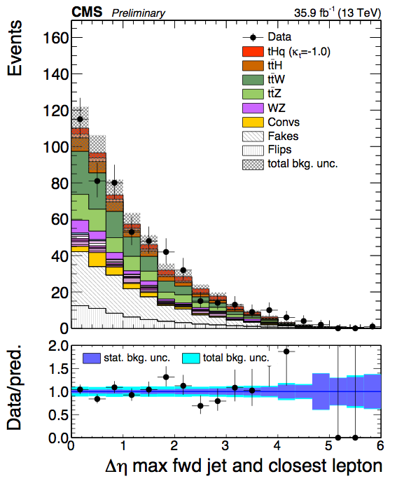
Signal region plots: 2lss-eµ
PAS
PAS
PAS

Slide 14
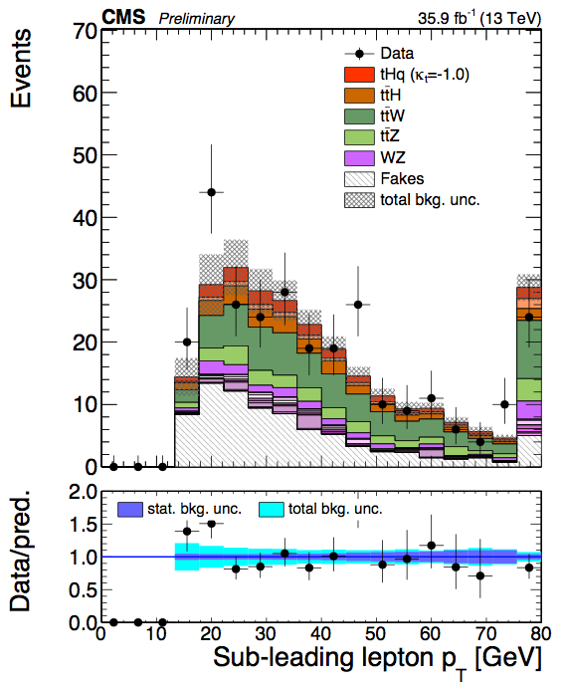
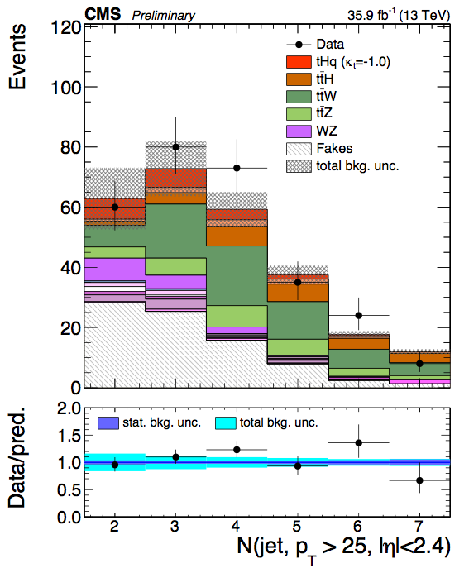
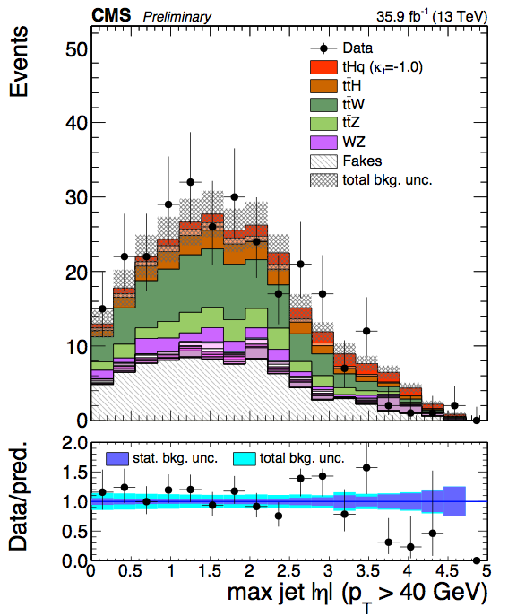
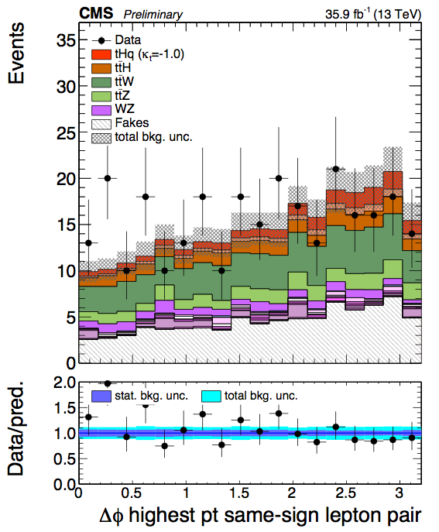
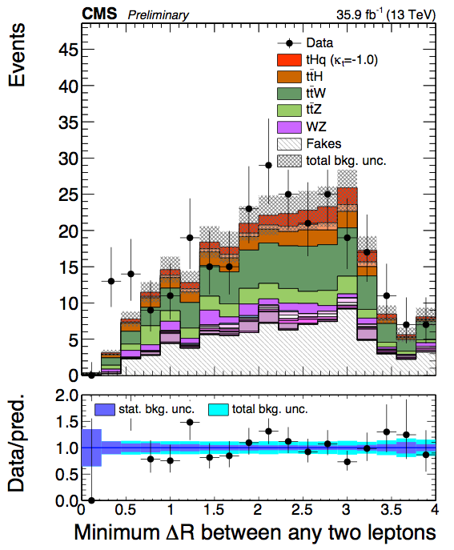
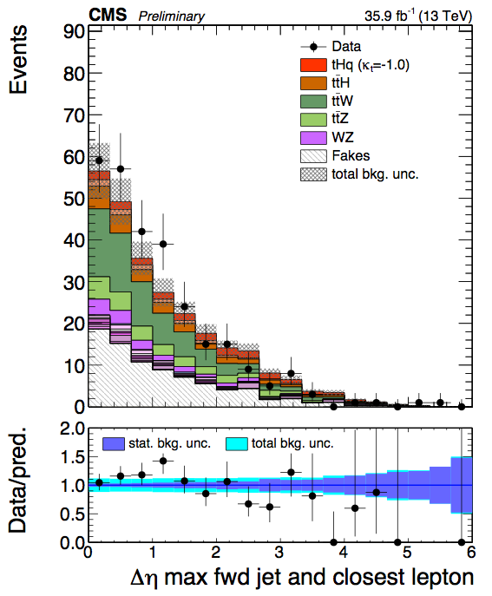
Signal region plots: 2lss-µµ
PAS
PAS
PAS

Slide 15
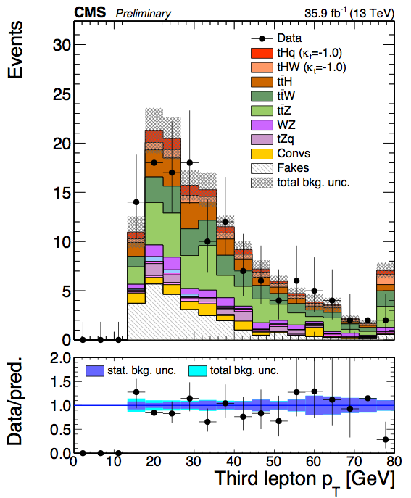
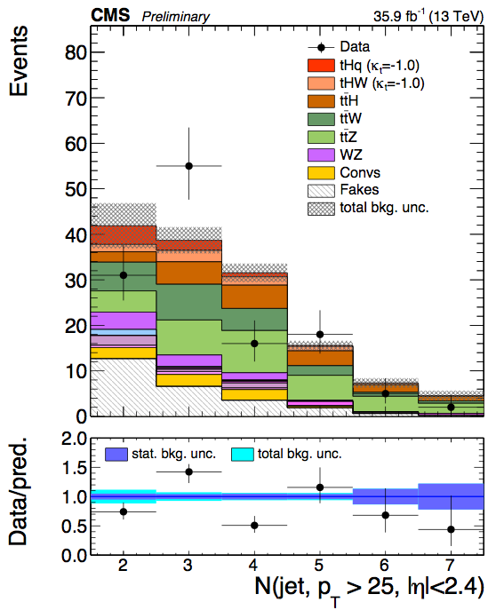
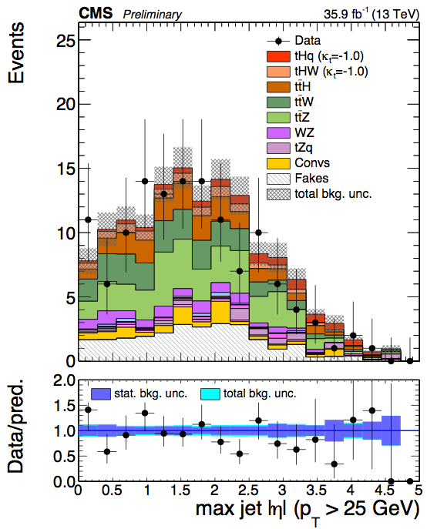
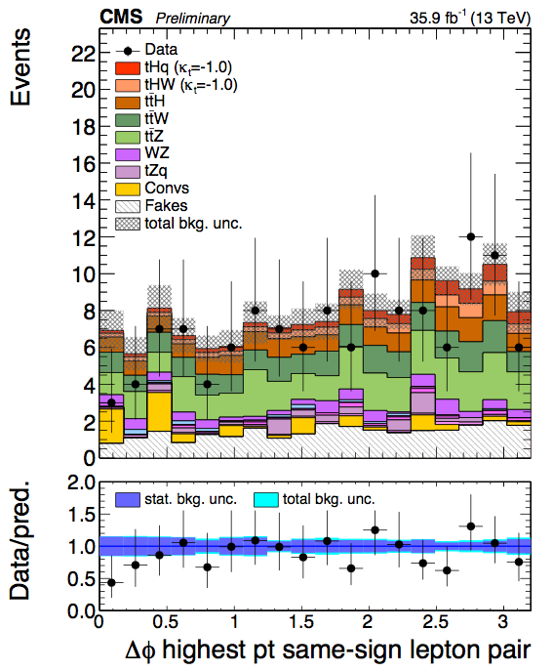
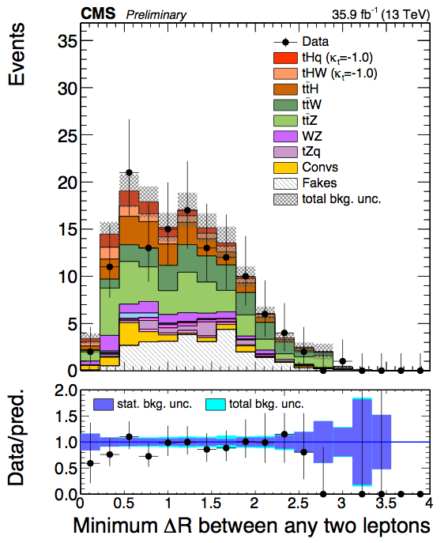
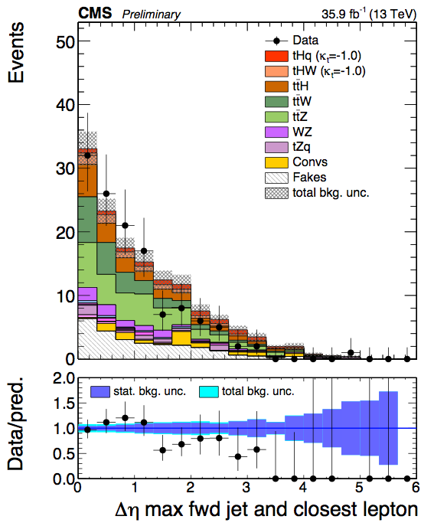
Signal region plots: 3l
PAS
PAS
PAS

Slide 16
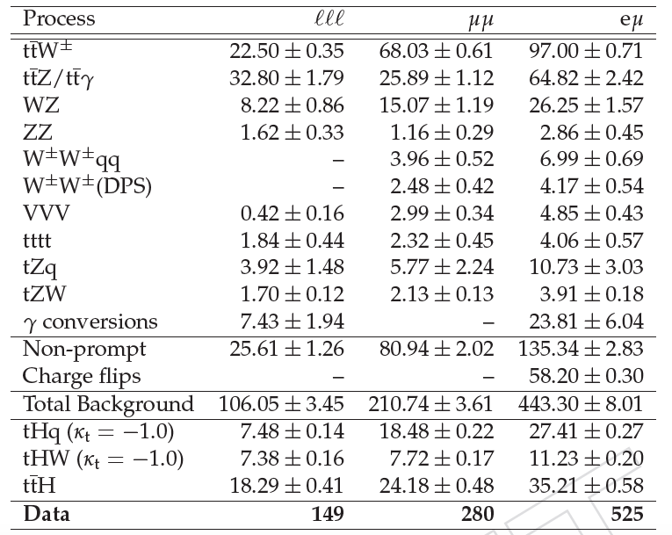
Data yields and expected background (35.9 fb⁻¹)
PAS
Uncertainties are statistical only.
Pre-fit

Slide 17


Signal discrimination using BDT
Two separate BDT trainings using MC samples for signal and backgrounds:
Signal is only tHq with 𝜅t = -1.0, 𝜅V = 1.0.
Against ttbar: non-prompt lepton type background.
Against combined ttZ and ttW: prompt lepton type background.
Separate trainings for 2lss and 3l channels using the following variables:
(other variations taken care
of via systematic uncertainties)
Trailing lepton pT
Total charge of tight leptons
min ΔR (lepton pairs)
Δφ between highest pT lepton pair
Number of jets with |𝜂| < 2.4
Number of non b-tagged jets with |𝜂| > 1.0
Maximum |η| for jets
Δη (most forward light jet, closest lepton)
Δη (most forward light jet, hardest loosely b-tagged jet)
Δη (most forward light jet, 2nd hardest loosely b-tagged jet)
Related to lepton kinematics
Related to jet multiplicities
Related to forward jet activity

Slide 18
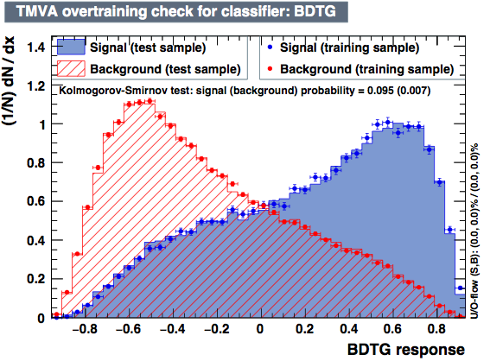
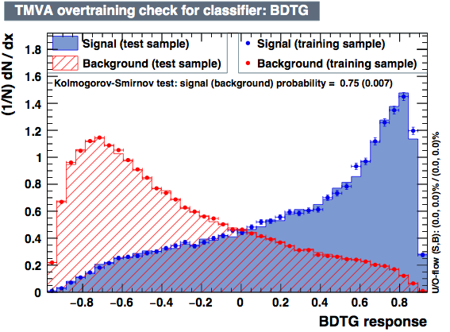
BDT training
BDT parameters:
Gradient boosted (BDTG)
No. of trees = 800
No. of cuts = 50
Maximum depth = 3
Found to be most discriminating, minimal overtraining.
ttbar BDT output (2lss)
ttV BDT output (2lss)

Slide 19
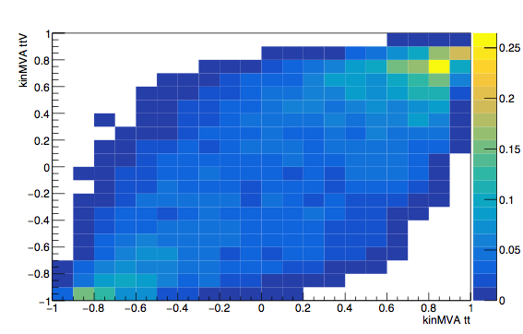
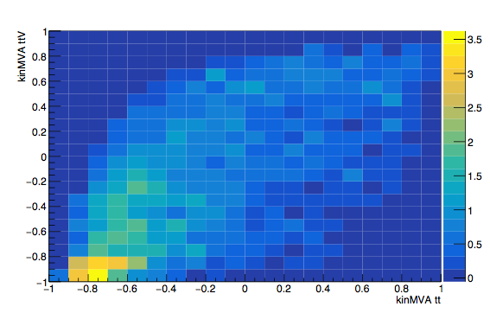
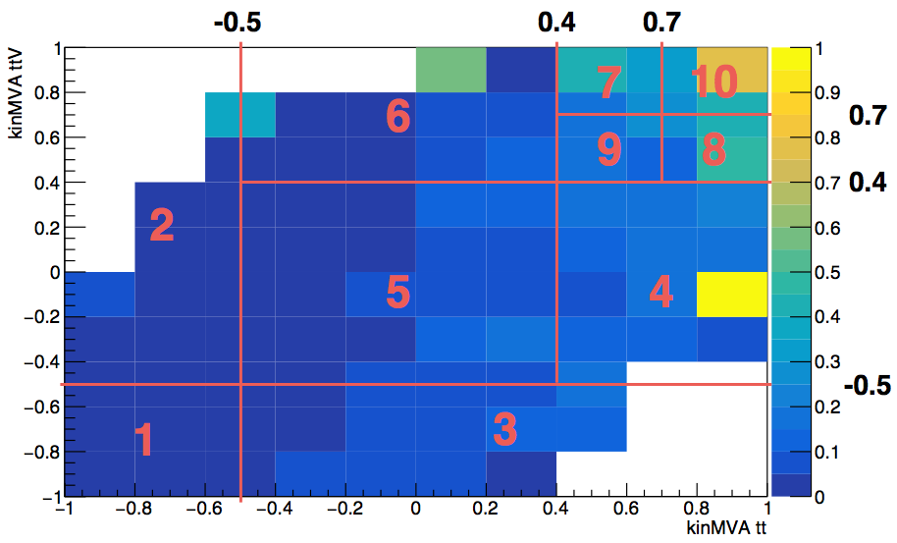
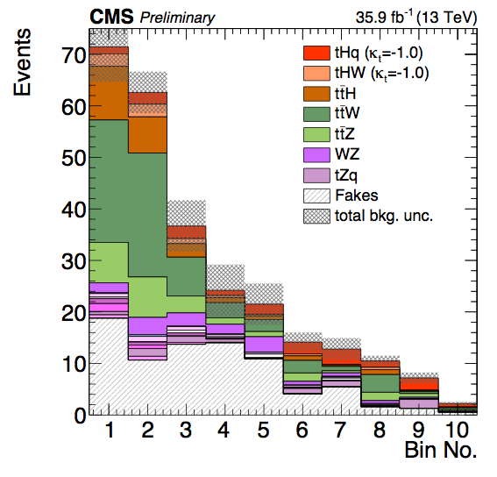
1D binned distribution for shape analysis
S (tHq+tHW)
B (all background)
Binning optimization
Optimization done on the basis of best obtained limit on expected signal strength for each channel.
Number of bins and bin borders were varied in the 2D plane of the S/B ratio.
Best limit was obtained for a set of 10 bins.
Other binning strategies were also tried in terms of expected limit:
S/B clustering: ~20% worse
k-Means clustering: ~10% worse
ttV BDT score
ttbar BDT score
S/B ratio
1D shape

Slide 20
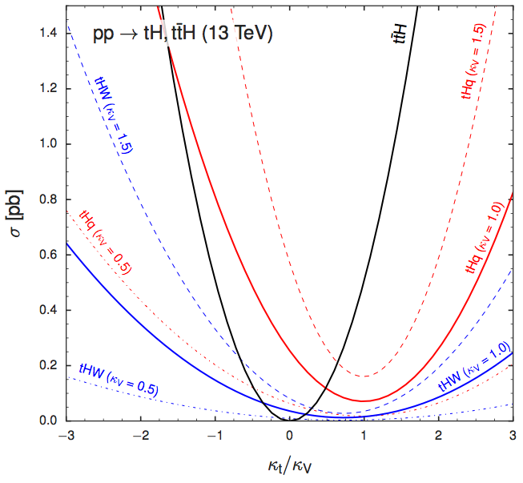
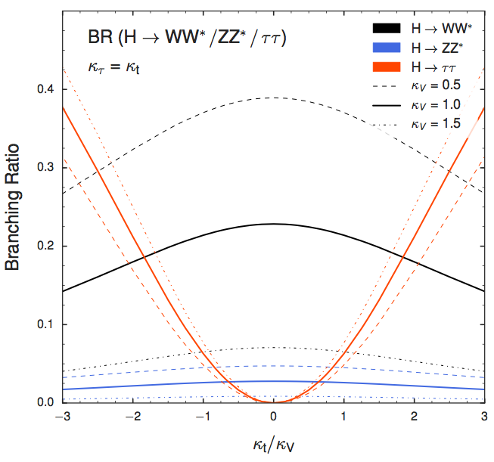
Signal Model
Aim: limit on common signal strength for (tHq+tHW+ttH) as function of 𝜅t/𝜅V. ttH is included as signal since its cross section varies as 𝜅t².
Signal shape depends on (i) 𝜅t/𝜅V ratio, (ii) relative fractions of tHq/tHW/ttH productions, and (iii) decay fractions of H→WW*/𝜏𝜏/ZZ*.
For 𝜅tau = 𝜅t → 𝜅t/𝜅V uniquely determines the signal shape.
𝜎(tHq) = (2.633 𝜅t² + 3.578 𝜅V² - 5.211 𝜅t𝜅V ) * 𝜎SM(tHq)
𝜎(tHW) = (2.909 𝜅t² + 2.310 𝜅V² - 4.220 𝜅t𝜅V) * 𝜎SM(tHW)
𝜎(ttH) = 𝜅t² * 𝜎SM(ttH)

Slide 21
Systematic uncertainties
Experimental:
Luminosity measurement: ~2.6%.
Data/MC scale factors for lepton selection (ID, iso) and trigger efficiencies, ~5% per lepton.
JEC and b-tagging efficiencies: used dedicated shape templates.
Forward jet modelling: shape templates from opposite sign ttbar CR.
Theoretical:
Choice of PDF set: ~3.7% for tHq
~4% for tHW, ttW, ttZ, ttH
Scale uncertainties: 12% for ttW, 10% for ttZ, +5.8/-9.2% for ttH. The values are coupling dependent in case of tHq/tHW, ~10% for SM.
Modifications in Higgs branching fraction also has uncertainty of order 1%.
Backgrounds:
WZ, ZZ sample modelling and statistics: ~50%.
Rare SM: ~50%, charge flips: ~30%.
Fake rate estimation:
The predicted event yield has a normalization uncertainty of ~30-50%. Smaller shape/normalization uncertainties from closure test.

Slide 22
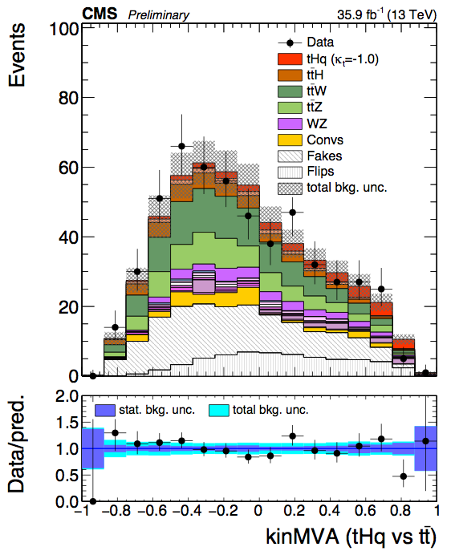
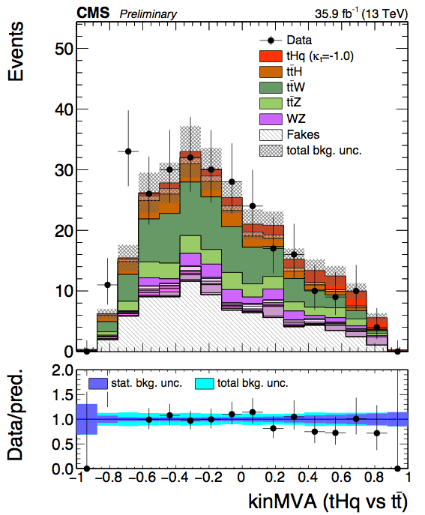
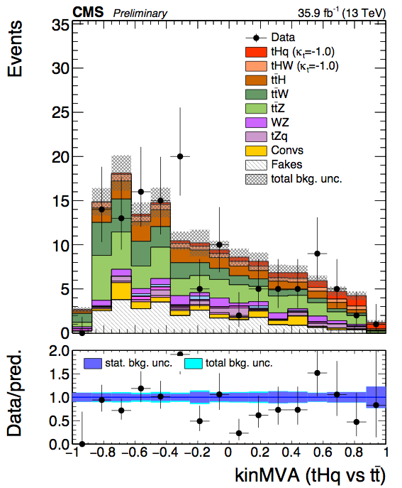
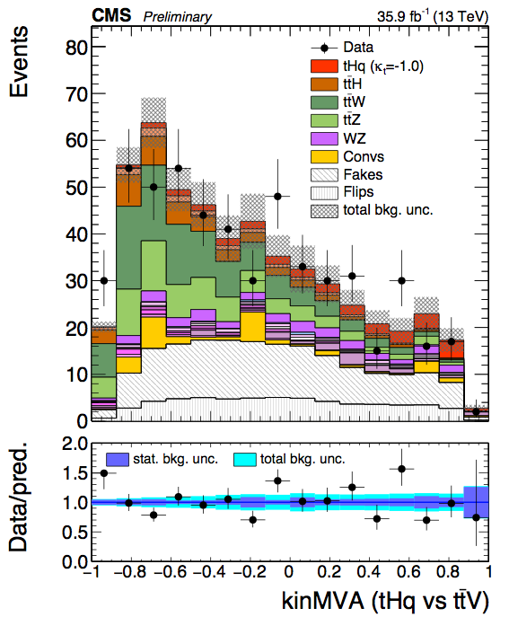
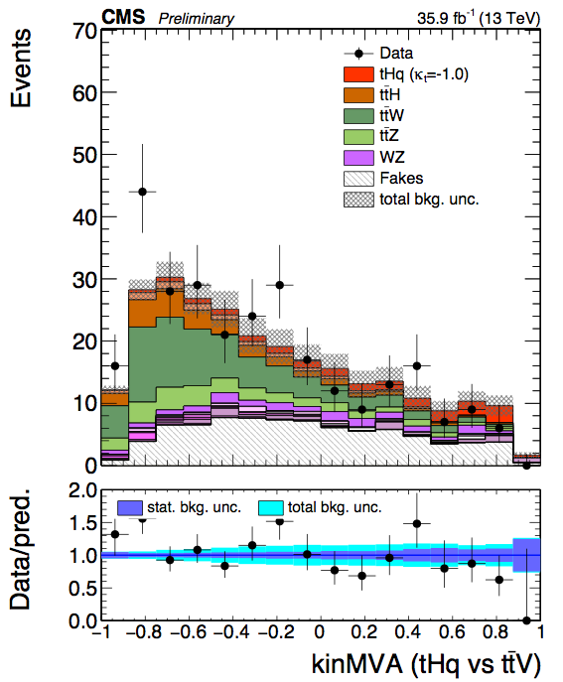
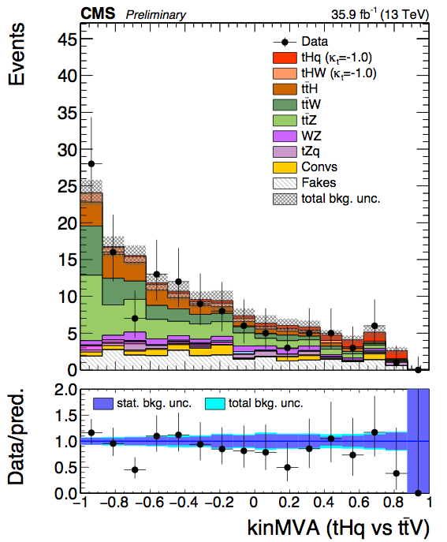
Pre-fit signal region plots: BDT outputs
PAS
2lss-eµ
2lss-µµ
3l
ttbar
ttV

Slide 23
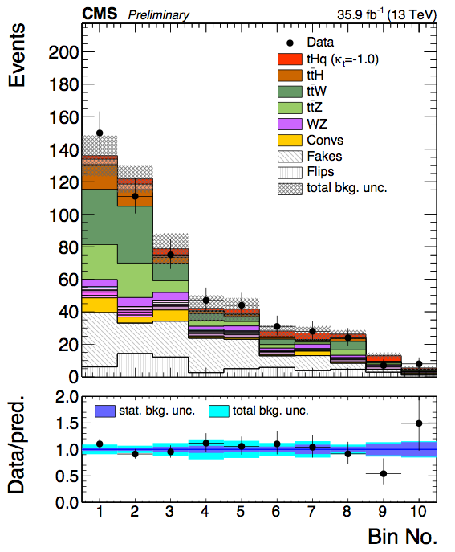
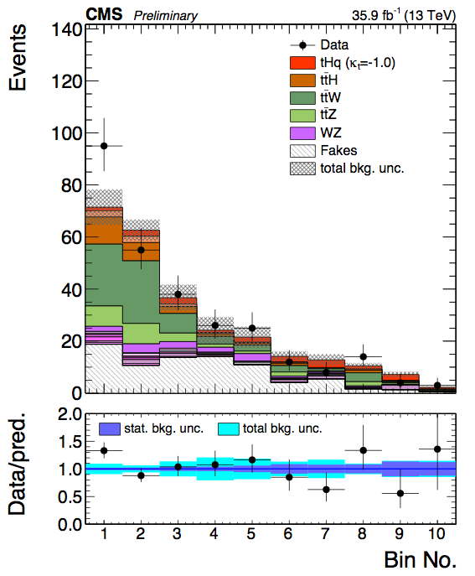
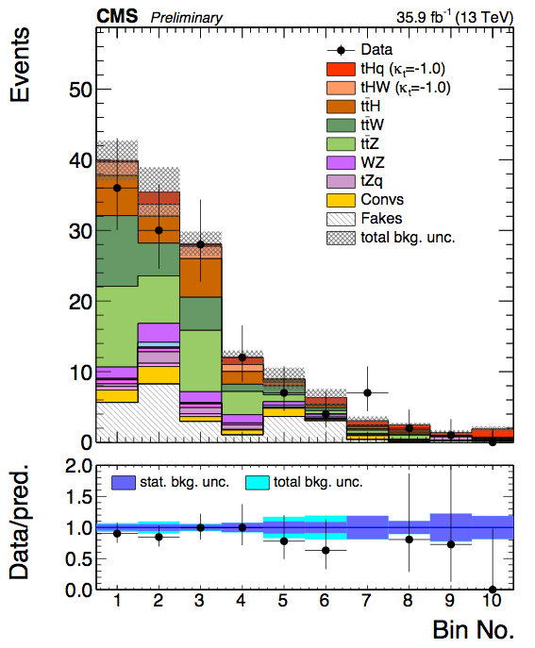
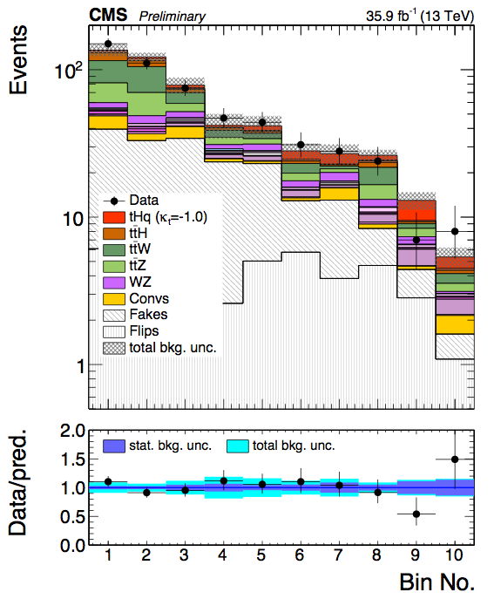


Pre-fit binning distributions
2lss-eµ
2lss-µµ
3l

Slide 24






Pre-fit binning distributions of background-subtracted
2lss-eµ
2lss-µµ
3l
𝜅V = -𝜅t =1
(SM)
𝜅V = 𝜅t =1

Slide 25






Post-fit binning distributions
PAS
2lss-eµ
PAS
2lss-µµ
PAS
3l

Slide 26






Post-fit binning distributions of background-subtracted
2lss-eµ
2lss-µµ
3l
𝜅V = -𝜅t =1
Best fit signal strength = 0.68
(SM)
𝜅V = 𝜅t =1
Best fit signal strength = 1.82

Slide 27

Fit results
Excess of about 1 𝜎 of expected SM-like tHq+tHW+ttH signal observed.
Sensitivity is limited by statistics.
Best fit signal strength for SM: r = 1.8 ± 0.3stat. ± 0.6syst.
 | Best fit signal strength | Best fit 𝜎xBR | Significance obs. (exp.)
𝜅t/𝜅V = -1 | 0.68 ± 0.40 | 0.30 ± 0.18 pb | 1.70 𝜎 (2.51 𝜎)
𝜅t/𝜅V = 1 (SM like) | 1.82 ^{+0.66} -0.67 | 0.33 ± 0.12 pb | 2.73 𝜎 (1.50 𝜎)
PAS

Slide 28


Expected (no Higgs) and
observed limit on 𝜎*BR
PAS
sign(𝜅t/𝜅V)
Expected limit is for a background-only Asimov dataset.
Right plot: limits as a function of sign(𝜅t/𝜅V)*𝜅t²/(𝜅t²+𝜅V²)
spans the finite range (-1, 1) for all possible values of the coupling modifiers.

Slide 29


Expected (including SM Higgs) and
observed limit on 𝜎*BR
excluded 𝜅V=1.0
excluded 𝜅V=1.0
sign(𝜅t/𝜅V)
Adding SM-like tHq+tHW+ttH to the Asimov data.
“Non-resolved” model for theoretical cross sections, i.e. H→gg/γγ/Zγ branching ratios (affecting the overall Higgs width) not scaled with 𝜅t, 𝜅V

Slide 30


Scan of best fit 𝜎*BR
sign(𝜅t/𝜅V)
Best fit signal strength of 0 in 𝜅t/𝜅V = 0 (where ttH=0)
excess is not due to (tHq+tHW).

Slide 31


Scan of observed & expected (no Higgs) significance
sign(𝜅t/𝜅V)
Expected from background only Asimov dataset.

Slide 32

Effect of nuisances (𝜅t/𝜅V=-1)
Fake rate
Post-fit pulls and impacts of the 20 most important nuisance parameters.

Slide 33

Effect of nuisances (𝜅t/𝜅V=1)
Fake rate
Post-fit pulls and impacts of the 20 most important nuisance parameters.

Slide 34
Conclusions
Results of tHq to multilepton final state analysis at √s = 13 TeV presented for the first time, using 2016 data.
Sensitivity improved significantly compared to 8 TeV result (r = 6.7 for 𝜅V = -𝜅t =1).
No longer statistically limited.
Limit on 𝜎(tHq+tHW+ttH)xBR(H→WW*, 𝜏𝜏, ZZ*) is presented as a function of the ratio of the Higgs coupling modifiers 𝜅t/𝜅V.
𝜅t values outside (-1.25, 1.6) are excluded at 95% C.L. for 𝜅V = 1.0.
We thank the ARC and the Higgs conveners for guidance.
Today we seek approval for this analysis.

Slide 35
excluded 𝜅V=1.0
excluded 𝜅V=1.0
Pallabi Das
2.05.2017

Slide 36
Back Up

Slide 37


Documentation
AN-16-378
HIG-17-005
ttH multilepton, 13 TeV (Moriond 2017): HIG-17-004, AN-17-029
tHq(Hbb), 13 TeV (ICHEP 2016): HIG-16-019, AN-16-065
8 TeV analysis: HIG-14-026, AN-14-140
tHq paper: arXiv:1509.08159

Slide 38


The tH signal process
A cross section modification similar to tHq can also be observed in case of the tHW production, which also has contribution from both ttH and WWH couplings.
SM(𝜅t = 1, 𝜅V = 1) cross section at 13 TeV is 𝜎SM = 15.61 fb.
For 𝜅t = -1, 𝜅V = 1, it becomes 𝜎ITC = 147.2 fb.
In the present study tHq and tHW are denoted together as the tH signal process.
The BDT training is optimized on the tHq process as signal for 𝜅t = -1, 𝜅V = 1.

Slide 39


Slide 40


Slide 41


Slide 42


Slide 43


Fake rate method
Used to estimate the non-prompt lepton backgrounds such as ttbar, DY, W+jets etc.
Fakes: real leptons from quark decays or mis-reconstructed jets.
Based on a loose and tight cut on a single variable, for our case: lepton MVA
Fake rate: probability of the fakeable objects to pass the tight selection in the fake dominated CR (QCD di-jet sample).
For example, in case of the 2lss channel, the fake prediction is:

Slide 44


Slide 45


Fake rate closure
Compare events with leptons passing tight selection in ttbar MC with (i) fake prediction on ttbar MC using FR measured in QCD sample FR(QCD), (ii) fake prediction on ttbar MC using FR measured in ttbar sample FR(TT)
Normalization (left) and shape (right) prediction, for BDT score against ttV in the 2lss eµ channel.

Slide 46


Slide 47



Data/MC scale factor modelling for forward jet
|𝜂| distributions of the most forward non-tagged jet in the tt-enriched opposite signed eµ selection for different pT cut values

Slide 48



Control regions for background estimation: 2lss-eµ
Selection for ttbar enriched CR:
Exactly two same sign tight leptons (eµ) with pT > 25/15 GeV.
b-jets: one or more jets passing CSVv2 medium w.p. (|𝜂| < 2.4).
Number of jets within |𝜂| < 2.4 is less than four.
Maximum (un-tagged) jet |𝜂| < 2 (to suppress signal region)

Slide 49



Control regions for background estimation: 2lss-µµ
Selection for ttbar enriched CR:
Exactly two same sign tight leptons (µµ) with pT > 25/15 GeV.
b-jets: one or more jets passing CSVv2 medium w.p. (|𝜂| < 2.4).
Number of jets within |𝜂| < 2.4 is less than four.
Maximum (un-tagged) jet |𝜂| < 2 (to suppress signal region)

Slide 50

Input variables for ttbar BDT: 3l

Slide 51

Input variables for ttbar BDT: 3l

Slide 52

Input variables for ttV BDT: 3l

Slide 53

Input variables for ttV BDT: 3l

Slide 54

Input variables for ttbar BDT: 2lss

Slide 55

Input variables for ttbar BDT: 2lss

Slide 56

Input variables for ttV BDT: 2lss

Slide 57

Input variables for ttV BDT: 2lss

Slide 58


BDT training: 3l

Slide 59


kinMVA variations with coupling
Change in the BDT output (3l) when varying the coupling. There is variation in shape.

Slide 60




Other binning strategies
2lss
3l
S/B clustering: binning corresponding to regions where S/B is within a certain range

Slide 61




Other binning strategies
2lss
3l
k-Means clustering: k-Means algorithm to separate the 2D plane into geometric regions

Slide 62



Expected (no Higgs) limit on
signal strength r as a function of 𝜅t

Slide 63

Signal yields split by decay channels

Slide 64

Scaling of cross section times BR

Slide 65

Best fit signal strength

Slide 66


Expected (no Higgs) and observed limit on cross section times branching ratio
sign(𝜅t/𝜅V)

Slide 67

Expected (no Higgs) and observed limit on cross section times branching ratio
PAS
H→gg/γγ/Zγ not resolved
H→gg/γγ/Zγ resolved

Slide 68


Overlap of ttH and (tHq+tHW)

